Slide 1

MetroMove Transit Solutions CAPSTONE PROJECT
“Optimizing Public Transit Operations: An Exploratory Data Analysis”
Nnaemeka
Sydney Nwani
August, 2025

Slide 2
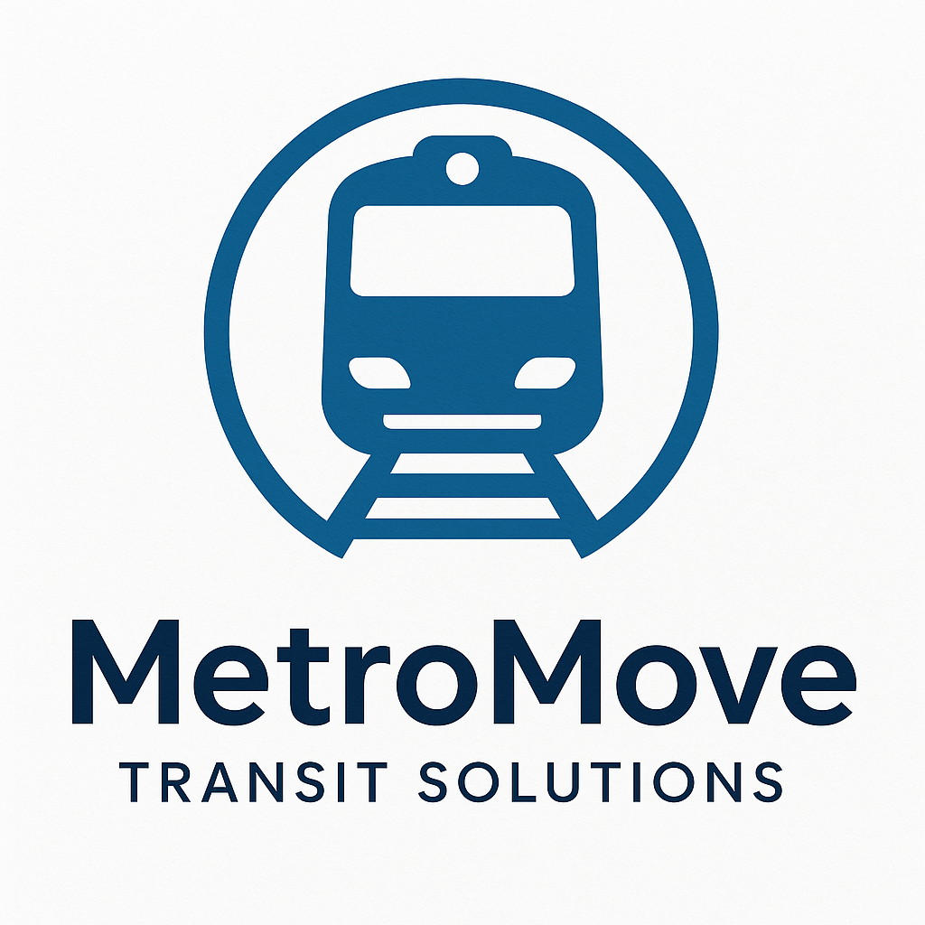
Introduction
MetroMove operates buses, trains, ferries, and trams across multiple cities.
Despite collecting large amounts of trip data, insights into passenger behavior, trip performance, and fare structures were limited.
This project leverages collected trip records to identify inefficiencies and patterns that can guide operational improvements.

Slide 3

Project Objectives
Identify passenger usage patterns across transport modes.
Evaluate performance of buses, trains, ferries, and trams.
Explore the relationship between fares, trip durations, and passenger counts.
Recommend strategies for more efficient and customer-friendly operations.

Slide 4

Dataset Overview
Key columns: Trip Date, Mode of Transport, Passenger Count, Fare Amount, Trip Duration, Departure and Arrival Stations
1000 trip records collected over 42 days
4 modes of transport - Bus, Train, Ferry, Tram
6 departure and arrival stations
49,039 total passengers
1,248,668 units in total revenue generated
Trip Departure Time ignored due to significant inconsistency

Slide 5
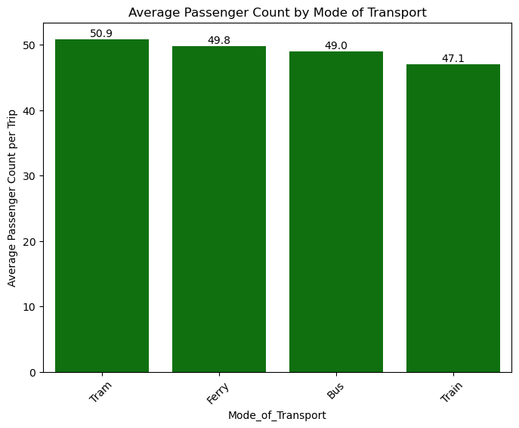
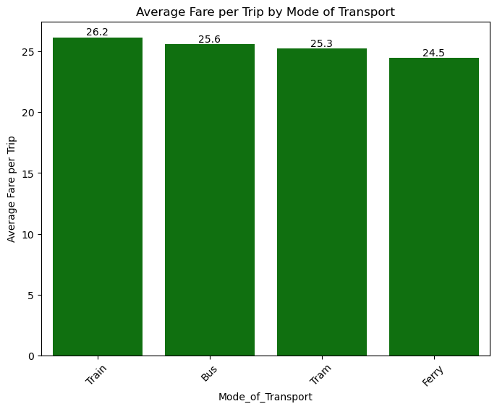
Passenger Usage Patterns & Behaviour Insights
On average per trip, more passengers utilized Trams while Trains were the least utilized, possibly due to higher cost
Modes with slightly higher fares (e.g., Train) had fewer passengers per trip on average.
This suggests that a good number of passengers may have been cautious of price while choosing transport modes.

Slide 6
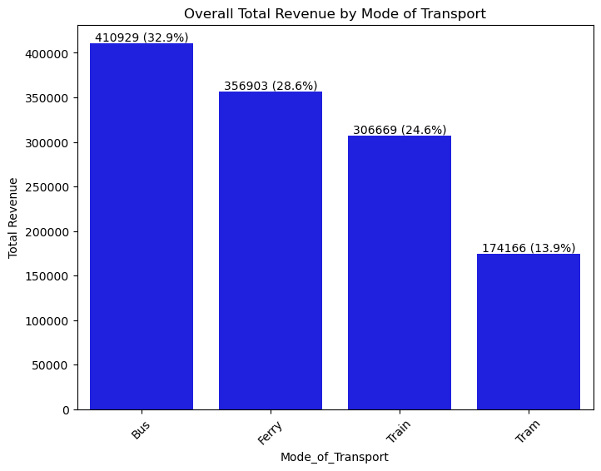
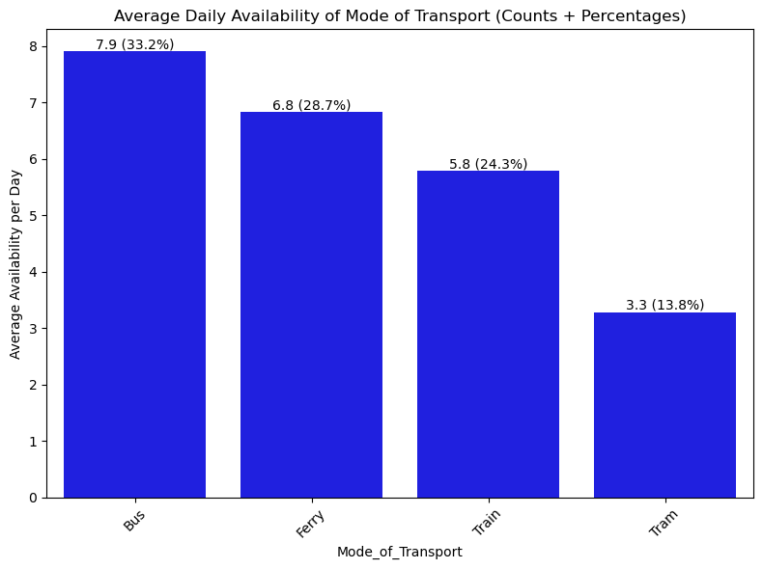
Revenue
Buses generate the most overall revenue as depicted in the chart,
Buses also generate the most revenue on average per day (chart not shown), followed by Ferry, Train and Tram in that order.
Buses are the most commonly available modes of transport both overall (not shown) and on average per day, followed by Ferry, Train, and Tram in that order.
It’s therefore likely that Buses top the chart on overall revenue due to their higher availability compared to other modes of transport.

Slide 7
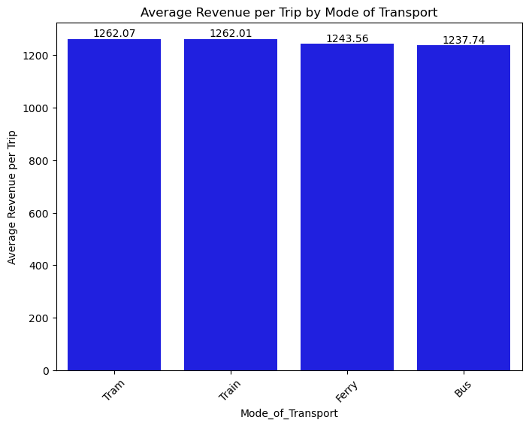
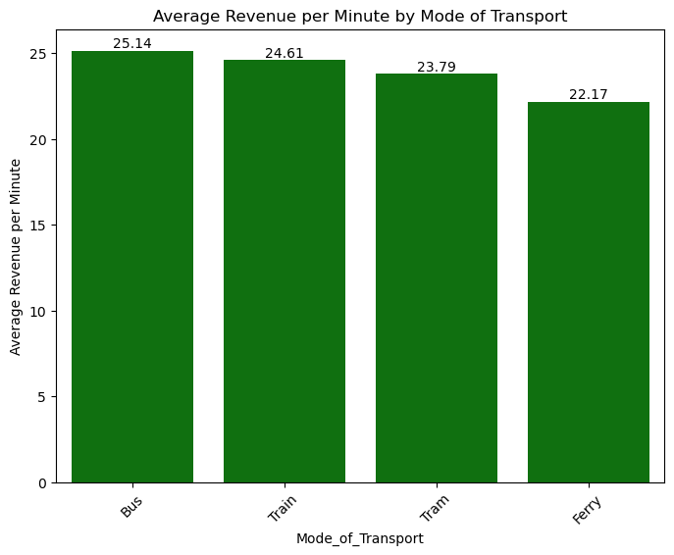
Revenue
On average per trip however, trams generate the most revenue as depicted in the chart, followed very closely by Trains
On a per minute of distance commuted basis, Buses are seen to generate the most revenue on average, followed by Trains, Tram and Ferry in that order.
From the charts displayed, it is difficult to categorically say that one mode of transport performs better than the other in terms of revenue generation. It all depends on how one decides to assess them.

Slide 8
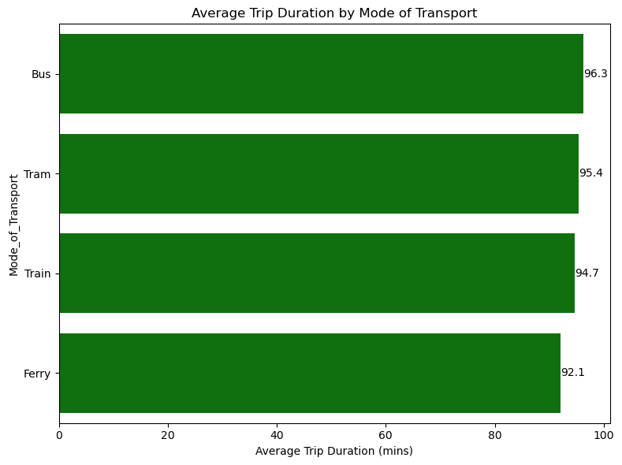
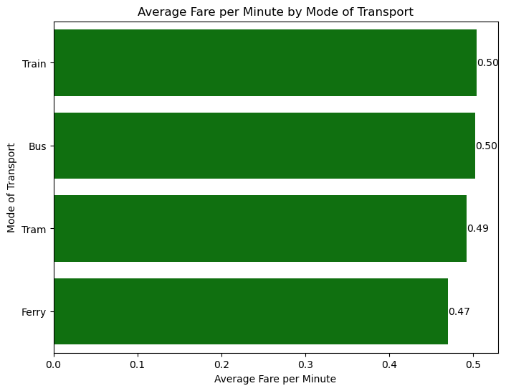
Performance Metrics
Average Trip Duration Per Mode:
Bus highest (96.3mins),
Ferry lowest (92.1mins),
Tram and Train mid-range 94.7-95.4mins).
Average Fare per Minute:
Train and Bus ~0.50 units per minute (highest).
Ferry lowest at ~0.47 units per minute.
Tram close at ~0.49 units per min.
Suggests similar trip duration across modes with Trains and Buses being more expensive per minute, while Ferries are cheapest and fastest on average.

Slide 9
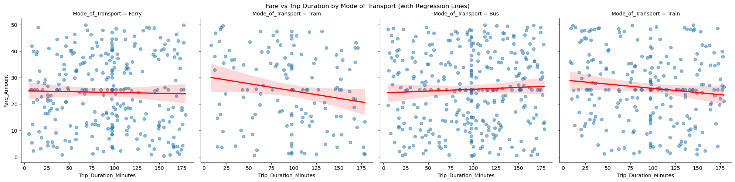
Relationship Between Fare & Duration
Surprisingly, very weak correlation between fare and trip duration:
Bus: +0.05 (almost no linear relationship). Ferry: –0.02 (slightly negative).
Train: –0.12. Tram: –0.18.
This indicates fares are not strongly determined by trip duration — suggesting a flat-rate or zonal pricing model.

Slide 10
Recommendations
Revisit Fare Policy: Since fare does not scale well with duration, consider aligning pricing more transparently with trip length.
Optimize Capacity: Trams and Ferries had the cheapest fees and highest passenger count on average per trip, whereas the buses were the most available. Therefore, consider reallocating resources to make more trams and ferries available so that average cost per trip could be lowered for passengers.
Promote Ferries: As the cheapest and fastest per-minute mode, ferries can be marketed as a cost-effective alternative to buses/trains.
Ensure collection of more accurate trip data records in the future, especially with regards to trip date and time of departure.

Slide 11
Conclusion
Passenger counts are slightly tilted towards the cheaper modes on average.
Trains and Buses cost more per minute, while Ferries are cheapest.
Fare and duration are weakly related — opportunity for restructuring.
Data-driven adjustments to pricing and capacity can enhance efficiency and passenger satisfaction.

Slide 12
Thanks for listening!!!

